Slide 1

Aloha! Tower Defense critical design review
Ryan Briner, Aaron Huff

Slide 2
Core Game Idea
The core idea that drives our game will be ‘cycles’. Calculations will be taken during these cycles, and the game will update visually to show the player what has happened.
Examples:
Enemies will move X distance in one ‘cycle’
Certain towers can only do damage every X ‘cycles’
Every ‘cycle’ the game will see if an enemy has reached the exit and subtract from the players overall health.
Every ‘cycle’ the game will see if an enemy has been defeated and add to the players overall money.

Slide 3
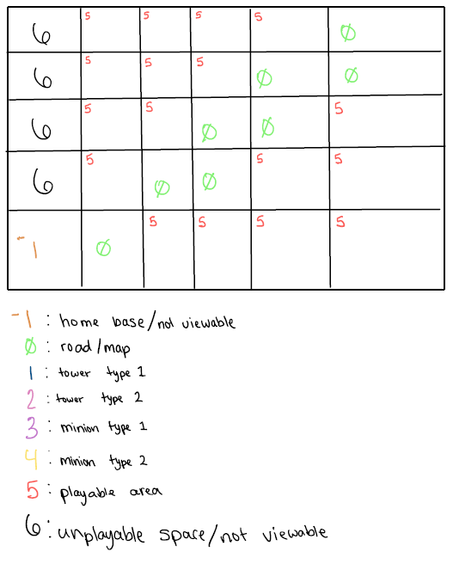

Slide 4
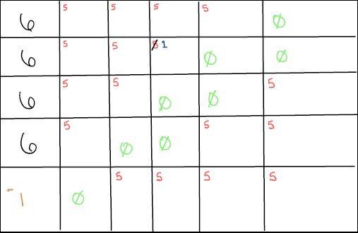
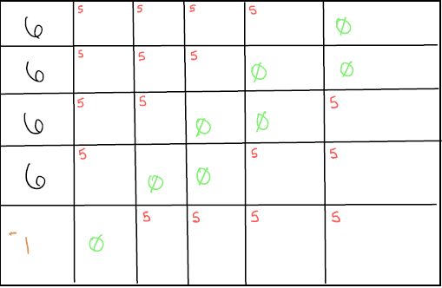
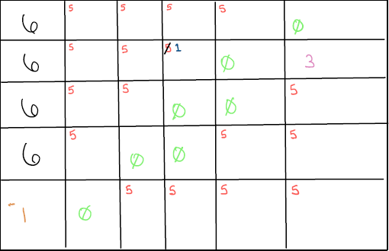
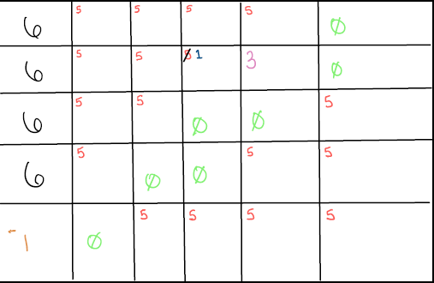
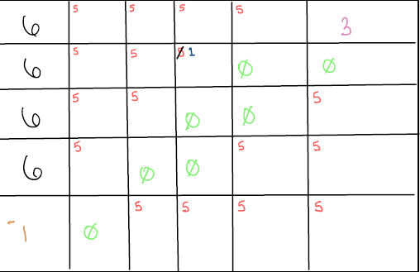
2D Array In Action
A “mob” enters the playable field and will follow along the path moving one square per refresh until reaching “-1” or “dying” to a turret.
During the refresh “3” was within “1’s” attack radius. “1” attacked, causing the hp of “3” to decrement, the value hit of “3’s” hp is now 0 causing it to be removed from the map and be replaced by the road value “0” again. When a minion’s hp reaches 0, the points counter is incremented by a value of 1.
Purchased a turret with the initial points granted to the player. The player has decided to place it at visible value C,2 {3,1}.

Slide 5
Map Code Plan
The bulk of the map will be built using a 2D array. This should give us a “grid” that we can work with.
By editing the values in each part of the array, we will be able to:
Display areas to place towers
Display placed towers and their radius.
Display the path that the enemies will travel along
Display the enemies themselves traveling as the game goes through cycles.

Slide 6
Enemy Code Plan
Enemy Counter: A value that will determine the amount of enemies that will be on each level. This counter will be used to:
Seed the “Enemies Remaining” value on the player’s screen.
Change the difficulty of each level by increasing.
Enemy Type: There can be multiple types of enemies. Making the use of different towers a good idea.
Example:
Some enemies may be slower but have higher hitpoints.
Some enemies may be faster but have lower hitpoints.

Slide 7
HUD Code Plan
Statistics that show on the players screen may include:
Enemies Remaining (Enemy Count – Enemies defeated)
Player’s Health (If enemy reaches the end of the path without being defeated, decrement players health by 1)
Player’s Money (Add money per enemy defeated)
Placeable towers (Show towers and their costs so that the player know what they can do.)

